Slide 1


Machine Learning Neural Networks
Portland Data Science Group
Created by Andrew Ferlitsch Community Outreach Officer August, 2017

Slide 2
Initial History
Neural Networks have been around a long time.
1943 - Warren McCulloch, a neurophysiologist and Walter Pitts,
a mathematician, published a paper on how neurons might work.
They modeled a simple neural network with electrical circuits.
1949 - The Organization of Behavior, by Donald Hebb reinforced
the concept of neurons.
1950s - Nathanial Rochester from the IBM research laboratories led the first effort to simulate a neural network.
1959 - Bernard Widrow and Marcian Hoff of Stanford developed
the first real neural network – MADALINE.
1969 - Marvin Minsky and Seymour Papert's 1969 book Perceptrons, kicked off the dissolutionment period where little
research continued until 1981.
i.e., demonstrated the Perceptron could not model an XOR operation.

Slide 3
Neuron
Neural Networks consist of Neurons
Inputs
X₁
The model (predictor)
The prediction
Can be:
Real value
Probability
Binary
Categorical
W₁
Inputs from
the features
(independent
variables) in
the dataset.
X₂
Neuron
Output Value
W₂
W₃
X₃
Weight (importance)
on how each feature
contributes to the output.

Slide 4
Neuron – Categorical Output
Neural Networks consist of Neurons
Inputs
Outputs
X₁
Y₁
W₁
X₂
Neuron
Y₂
Categorical
Outputs
(e.g., Apple, Pear, Banana).
W₂
W₃
X₃
Y₃
Neuron outputs only
a single value.
Output nodes Y₁, Y₂ and
Y₃ each weight the output
from the neuron and make
a separate calculation for
their final output.

Slide 5

Neuron - Details
Neural Networks consist of Neurons
Inputs
X₁
Normalize (0..1) or Standardize the inputs (feature scaling)
so no input dominates another.
Backward propagation to
adjust (learn) the weights
(e.g., Gradient Descent).
W₁
X₂
Neuron
Output Value
W₂
W₃
Ø(
$$\sum_{i=0}^{n}{wi ∗xi}$$
)
X₃
Summation of the weighted inputs
The higher the weight,
the more it contributes
to the outcome (prediction).
Activation function

Slide 6
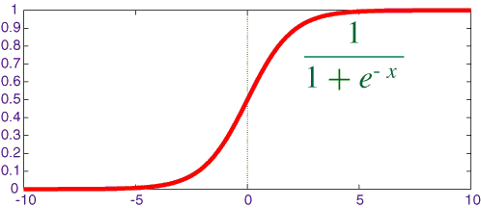
Activation Functions
Most Common
Threshold – Either a zero or one is outputted (binary).
Ø(x) =
Sigmoid – A Curve that converges exponentially towards 0 for
x < 0 and 1 for x > 0.
{
1 if x ≥ 0
0 if x < 0
}
Convergence to one
Popularly used in
output nodes for
probability prediction.
Also referred to as
a squashing function,
Squashing the output between 0 and 1.
Convergence to zero

Slide 7
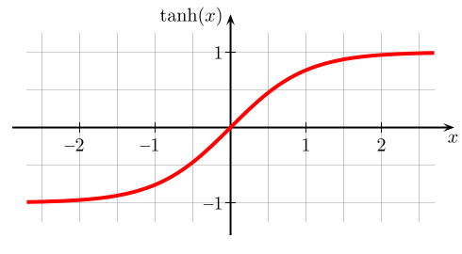
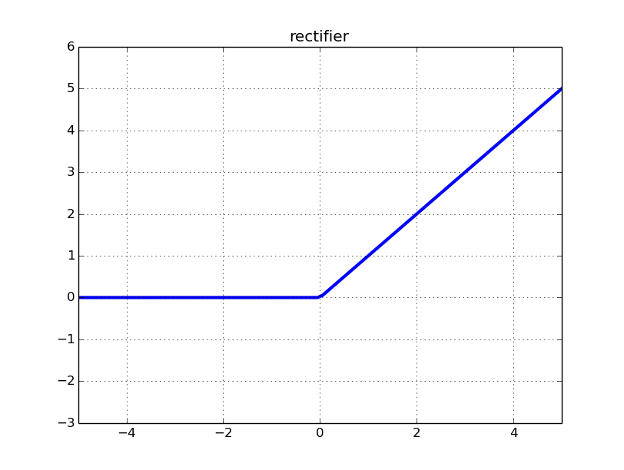

Activation Functions
Most Common
Hyperbolic Tangent – converges to -1 for x < 0 and 1 for x > 0.
Ø(x) = $\frac{1 − e^{−2x}}{1+ e^{−2x}}$
Rectifier – 0 if x <= 0, otherwise x
Ø(x) =
Ø(x) = max(0,x)
Also referred to as
a squashing function,
Squashing the output between -1 and 1.
{
0 if x ≤ 0
x if x > 0
}
Popularly used in
hidden layers for
outputting to the next
layer.
Alternate representation.

Slide 8
Fully Connected Neural Network (FCNN)
Full Connected Neural Network consists of:
Input Layer – inputs from the data (samples).
Output Layer – the predictions.
Hidden Layer(s) – Between the input and output layers, where the learning occurs.
All nodes are connected to every other node in the next layer.
Activation Functions – where outputs are binary, squashed, or
rectified.
Forward Feeding and Backward Propagation - for learning the weights.

Slide 9

Fully Connected Neural Network (FCNN)
Hidden Layer
Simple FCNN:
- One Hidden Layer
- One Output Node
Input Layer
X₁
Output Layer
X₂
ŷ
Sigmoid Activation Function
Squash into a probability.
X_{n}
Rectifier Activation Function (ReLU)
If below zero, then
Output no signal.
Acronym

Slide 10
Deep Neural Network (FCNN)
Hidden Layers
It’s a Deep Neural Network
if it has more than one hidden
layer – That’s It!
Input Layer
X₁
Output Layer
X₂
ŷ
X_{n}

Slide 11
Hidden Nodes are Specialized Learners
Each Node in the Hidden Network Specializes
18-25 (low income)
Learns weights to best predict when age is young and
income is low (i.e., they spend their parent’s money).
Sample
W₁₋₁
Age
Outputs high signal
< 25
W₂₋₁
ŷ
Spending
Income
< 1000
Outputs low or no signal
The more hidden nodes, the more specialized learners

Slide 12

Cost Function
Calculate Cost (Loss) During Training
One of the most commonly used
cost functions for neural networks.
C = $\frac{1}{2}\left(y −\text{ŷ}\right)2$
Data
Age
W₁₋₁
< 25
W₂₋₁
ŷ
Spending - ŷ
Income
< 1000
Predicted
And actual.
y (label)
y

Slide 13

Feed Forward - Training
Feed Forward Training Loop
Training Data
Data
Data
Data
Neural Network
Data
Feed a single
row of data at
a time.
Calculate the cost (loss).
Repeat
C = $\frac{1}{2}\left(y −\text{ŷ}\right)2$
Feed the next row
of data.
Converge ?
Adjust Weights
Refeed same data while still minimizing loss
Make small adjustments to
weights in the neural network.
Can’t minimize the loss
Anymore.

Slide 14

Feed Forward - Training
Feed Forward Training Loop
Neural Network
Training Data
Data
Data
Data
Data
Calculate the cost (loss).
Feed a single
row of data at
a time.
C = $\frac{1}{2}\left(y −\text{ŷ}\right)2$
Make small adjustments to
weights in the neural network.
Converge ?
No
Adjust Weights
Summation
∑ C = $\frac{1}{2}\left(y −\text{ŷ}\right)2$
Repeat
Yes
Stop
Can’t minimize the cost
function anymore.
Run the training set again
through the neural network.
Each run is called an Epoch.
Trained Neural Network

Slide 15
Multiple Output Nodes - Softmax
Squashes a set of input values into 0 and 1 (probabilities), all adding up to 1.
Hidden Layer
Classification
probabilities, e.g.,
90% apple
6% pear
3% orange
1% banana
Input Layer
Output Layer
z₁
Softmax
f(z₁) ∈ R{ 0, 1 }
x₁
z₂
f(z₂) ∈ R{ 0, 1 }
x₂
z₃
f(z₃) ∈ R{ 0, 1 }
x₃
z_{k}
f(z_{k}) ∈ R{ 0, 1 }
Features
Each output node specializes on a different classification.
Predicted
output
(real) values

Slide 16
Final Note – Training vs. Prediction
Once we have trained the neural network, we do not have to
repeat the training steps when using the model for prediction.
No repeating of Epochs, Gradient Descent and Backward Propagation.
The model will run much faster than during training.

